Slide 1

Morning star European Funds
Pavani chella
Siddarth
Abishek Chiffon

Slide 2
CONTENTS
INTRODUCTION
OBJECTIVE
DATASET
METHODOLOGY
RESULTS
CONCLUSION

Slide 3
INTRODUCTION
In the fast-changing world of money , where things are always moving, we're diving into the interesting world of Mutual Funds With the help of Morningstar European Funds' info, we're checking out how these money things perform and what risks they have. Morningstar is like the expert guide here, known for understanding numbers and money things.
Our goal is to figure out what makes these Mutual Funds tick in a simpler way. We're on a cool journey to understand how they've done in the past and what risks they might have. It's like solving a puzzle with numbers! So, come along on this short, fun trip where we explore the world of money and make sense of how things work. Welcome to an adventure where we turn numbers into smart decisions!

Slide 4
OBJECTIVE
Our overarching objective is to conduct a thorough comparative analysis of Mutual Funds, seeking insights into their historical performance, volatility, and a range of financial ratios.
The project's ultimate goal is to not only understand the present state of these investment vehicles but also to build predictive models that forecast their future performance.
Through meticulous examination, we aim to provide valuable insights that can inform investment decisions and strategies.

Slide 5
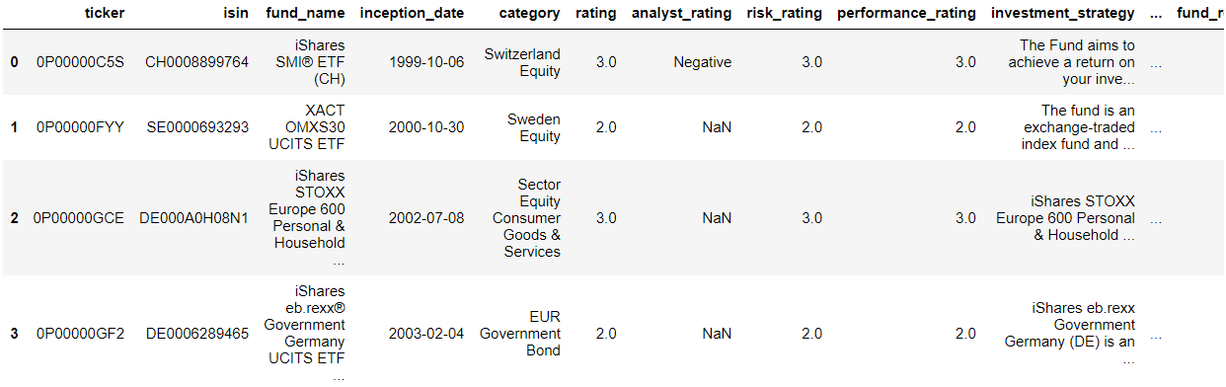
DATASET
1) Morningstar European Mutual Funds
No of rows : 57603
No of columns: 132

Slide 6
ANALYSIS
Data Cleaning:
We initiated the dataset cleaning process by excluding columns with over 30 percent missing values. To address the gaps in the data, we employed an imputation technique. For columns exhibiting a normal distribution, we filled missing values with the mean. In cases of skewed distribution, the median was used for imputation. Categorical columns underwent imputation using the mode. This meticulous approach ensures the dataset's integrity, paving the way for accurate and reliable analysis.

Slide 7
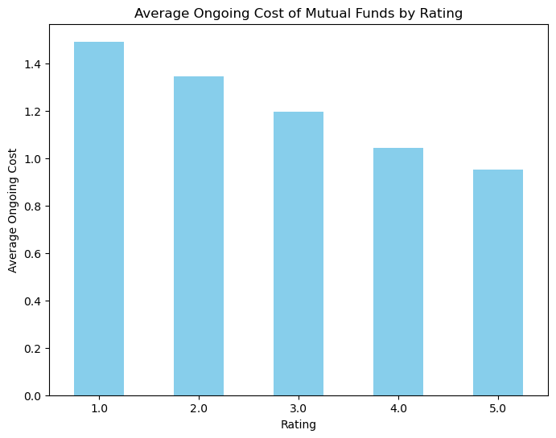
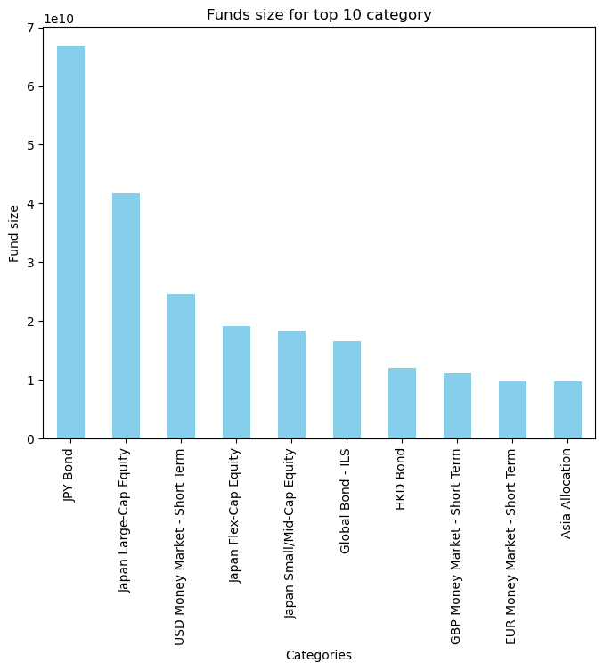
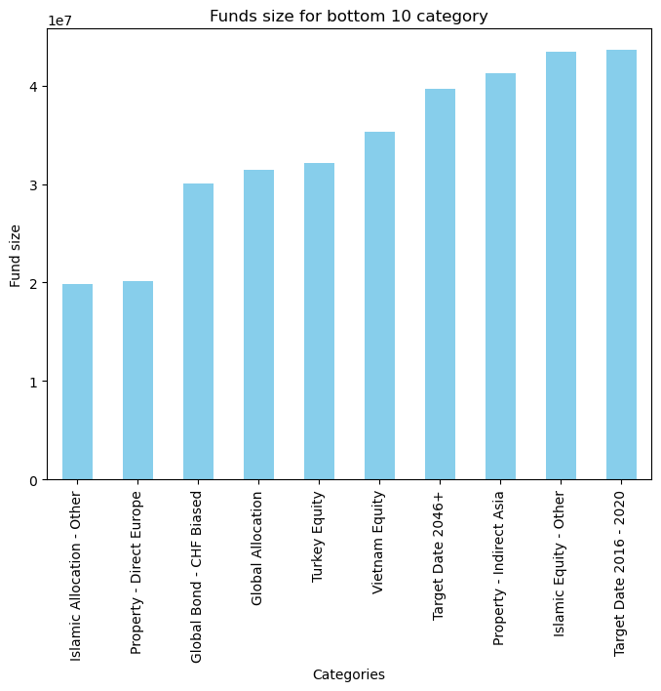
Average ongoing cost of Mutual Funds by Rating Fund size for top and Bottom categories

Slide 8
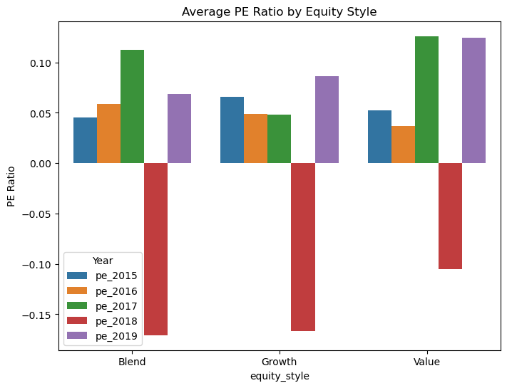
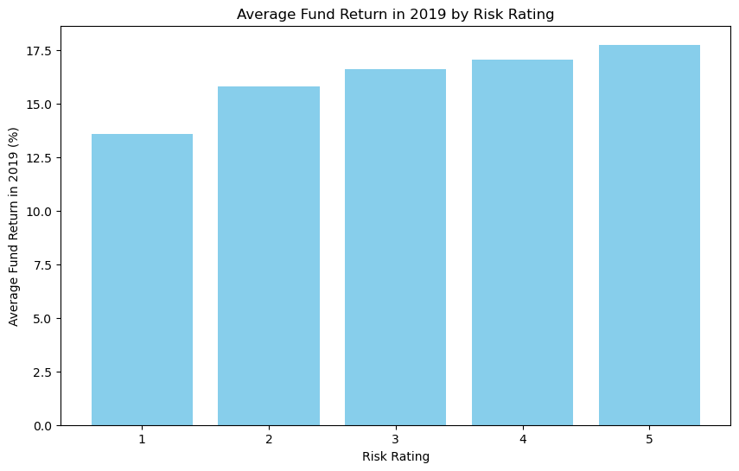
How has the average Price to Earnings (P/E) ratio changed over the past five years
across different equity styles?

Slide 9
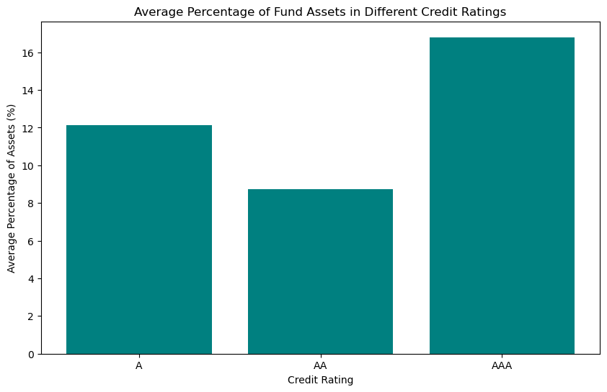
What percentage of funds based on credit rating

Slide 10
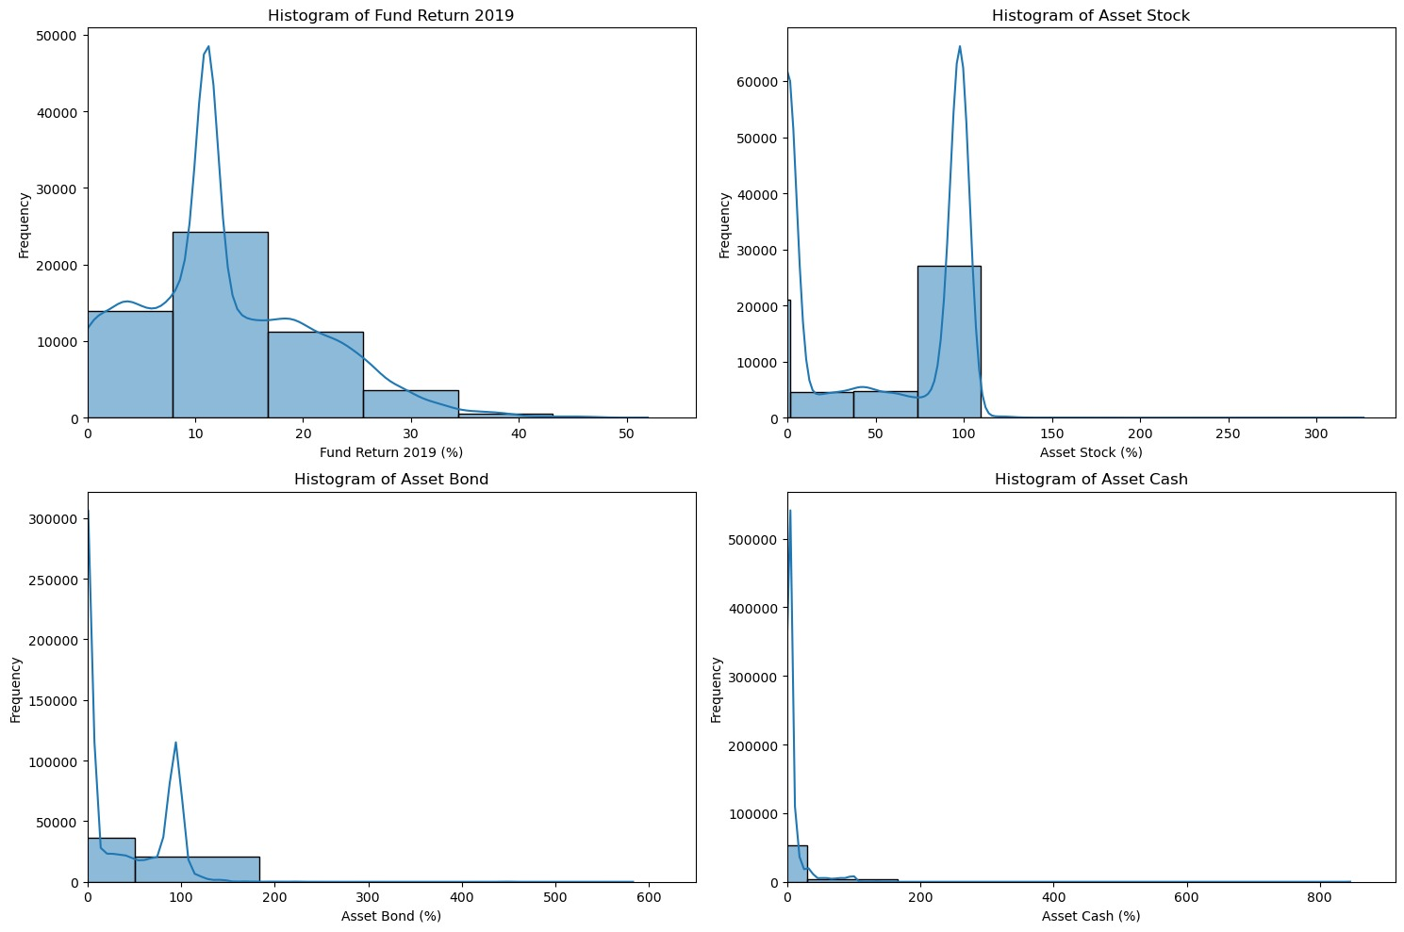
Histograms of Financial Returns and Asset Levels

Slide 11
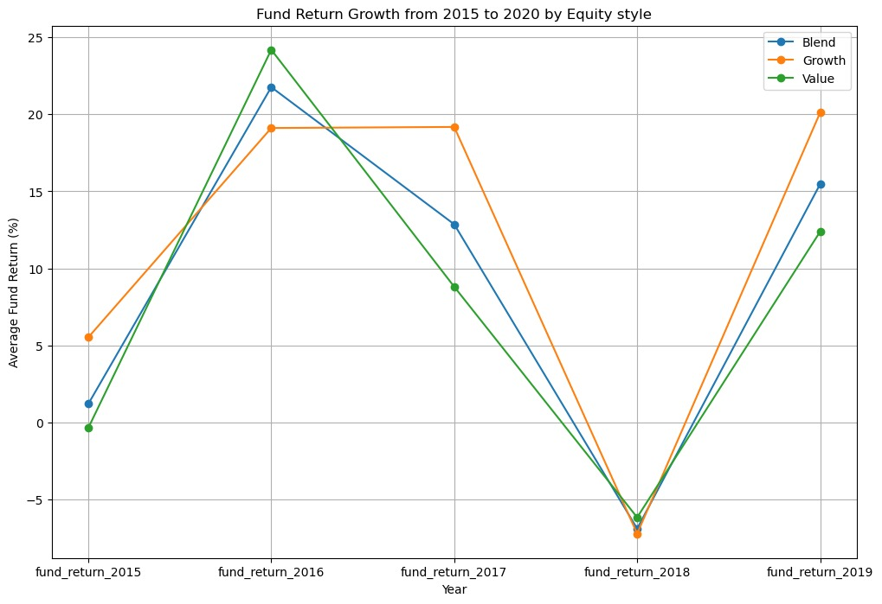
Fund Return Growth from 2015 to 2020 by Equity Style

Slide 12
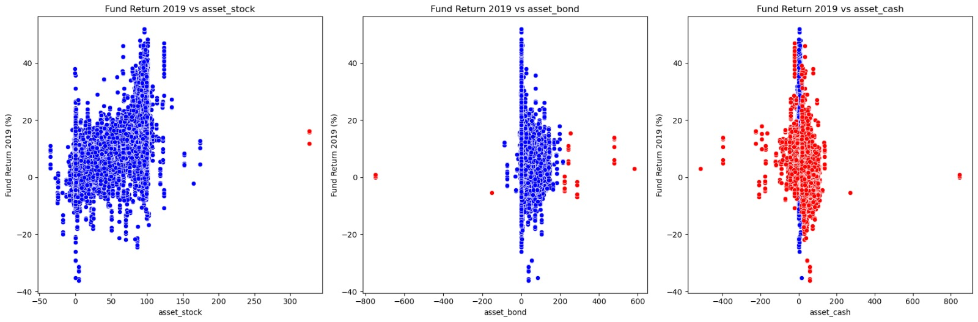
Fund Return 2019 vs asset levels

Slide 13
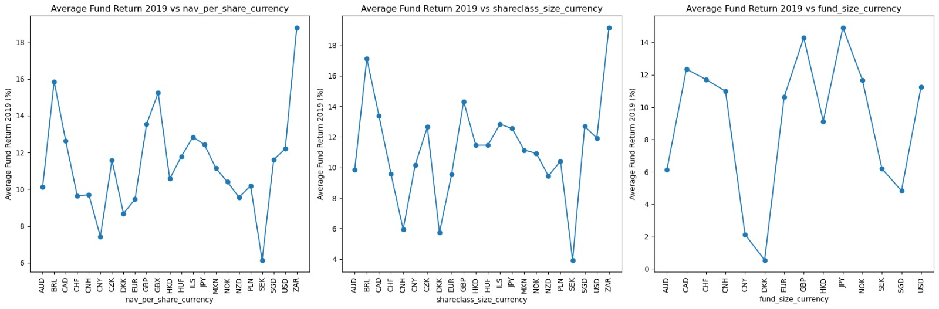
Average Fund Return vs currency

Slide 14
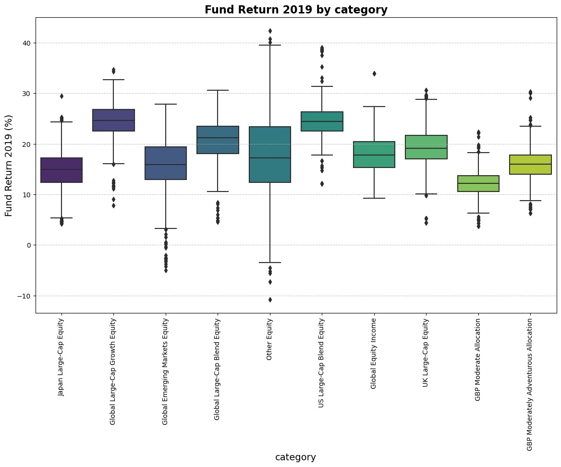
Fund return 2019 by category

Slide 15
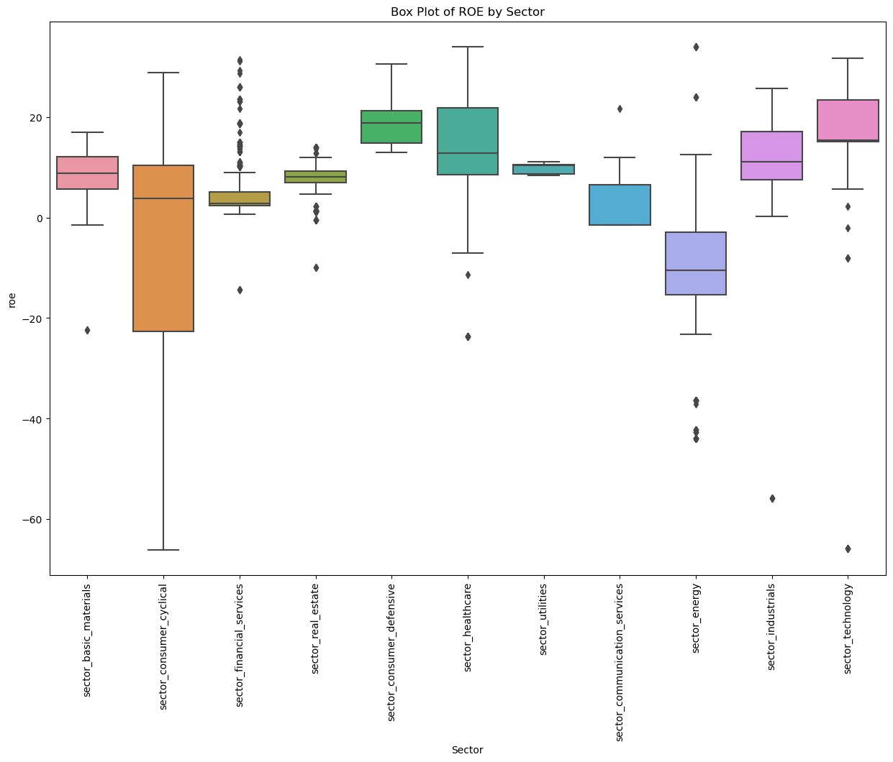
Box plot of ROE by sector

Slide 16
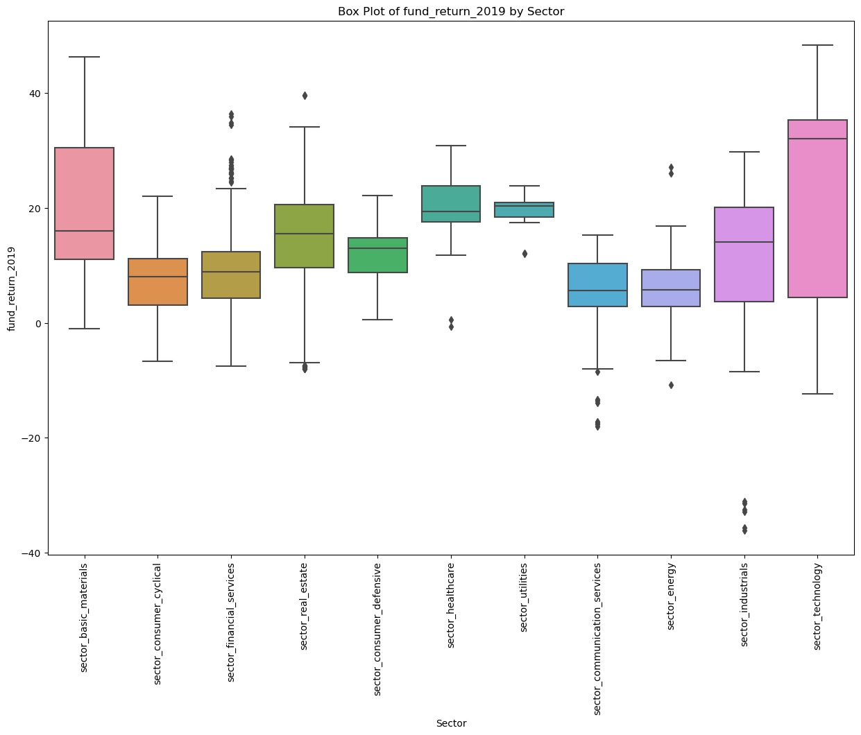
Box plot of fund_return_2019 by sector

Slide 17
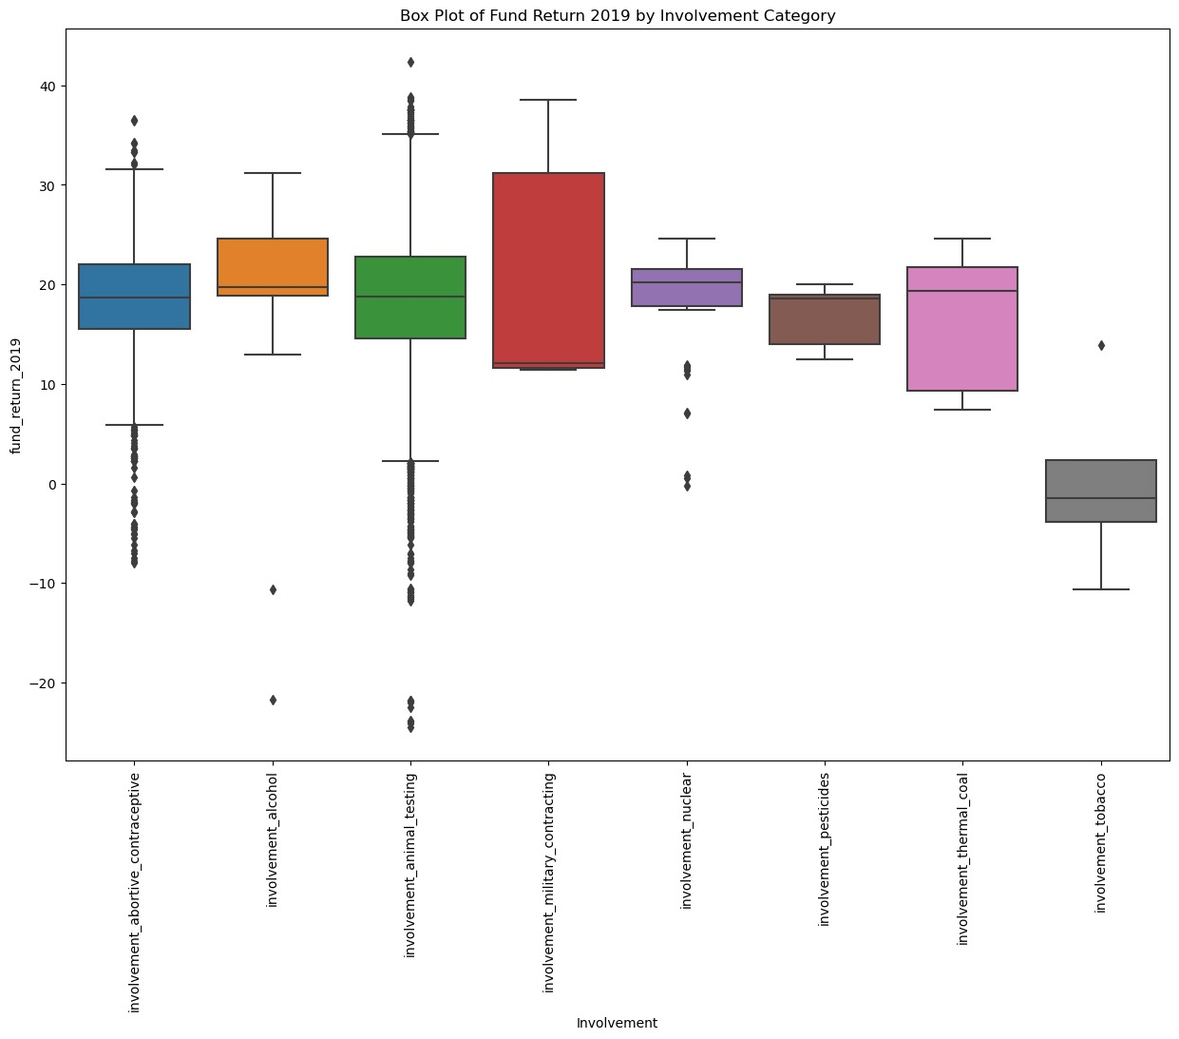
Box plot of Fund Return 2019 by Involvment category

Slide 18
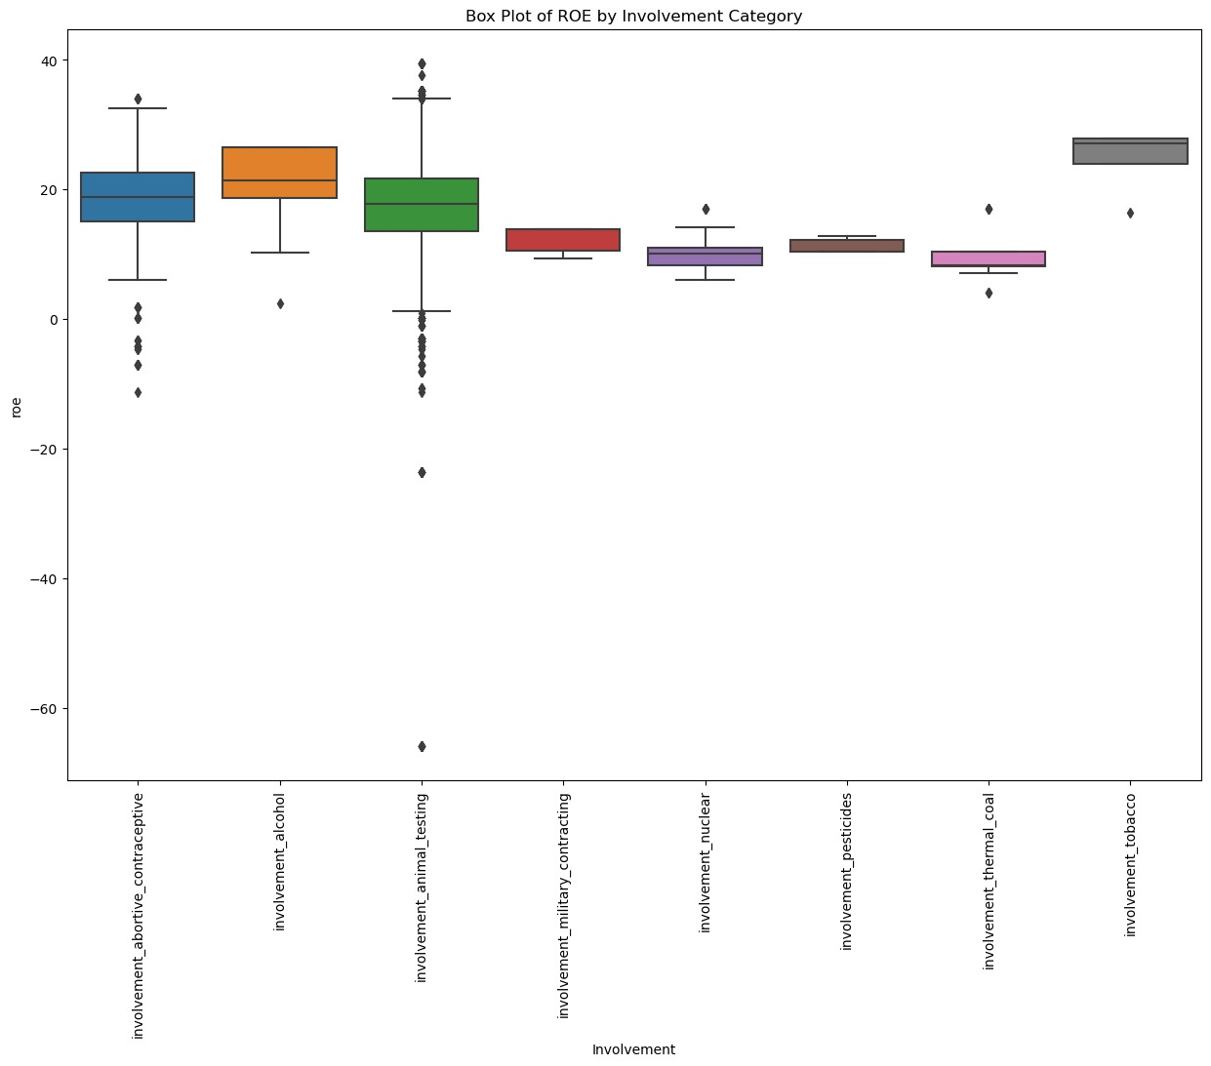
Boxplot of ROE by involvement Category

Slide 19
METHODOLOGY
Our approach to predicting fund performance employs a suite of models tailored to the dataset. Linear Regression is used for straightforward cases with a clear linear correlation. Random Forest aggregates predictions from multiple decision trees for a comprehensive forecast, and Gradient Boosting enhances accuracy iteratively. Implementation involves data preparation, feature engineering, model selection, training, validation, and evaluation, with iterative fine-tuning. The goal is to extract insights for informed decision-making, aiming to forecast fund performance effectively based on historical data and trends.

Slide 20
Feature Selection methods
1 Correlation based selection
2. Linear regression based selection
3. Krushkal Wallis selection for categorical variables

Slide 21
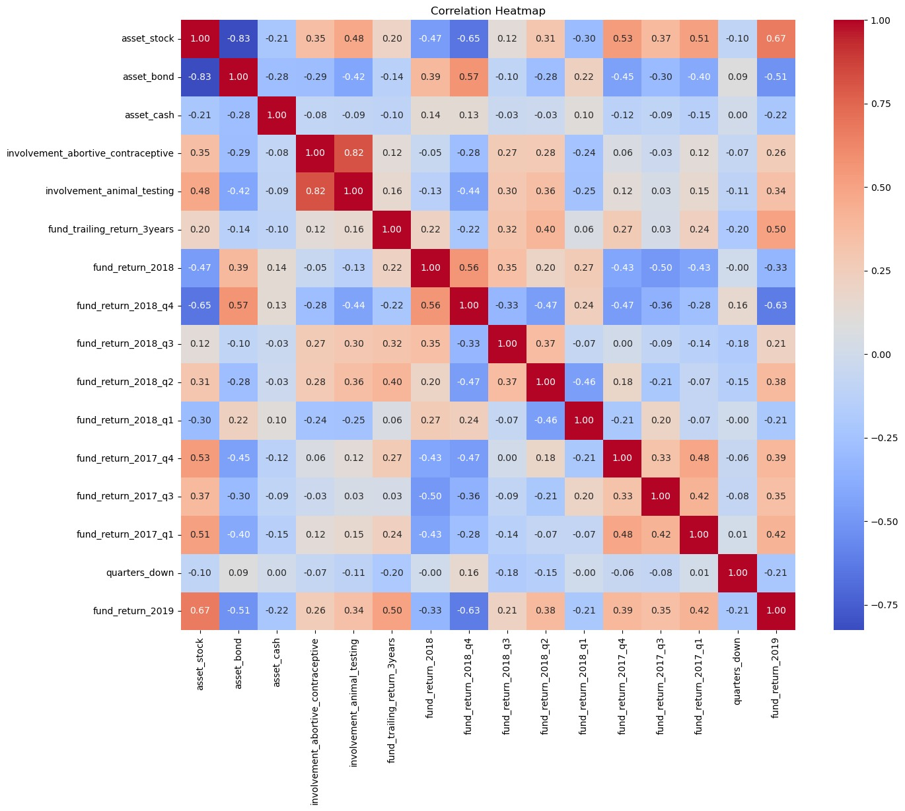
Correlation Heatmap between Financial Returns and Asset Levels

Slide 22
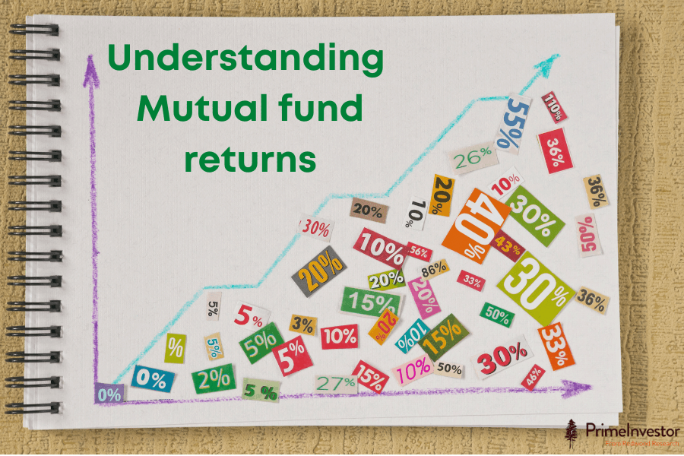
Why didn't we remove columns based on collinearity

Slide 23
Models employed
RandomForest
2. XgBoost
3. Elastic Net regressor

Slide 24
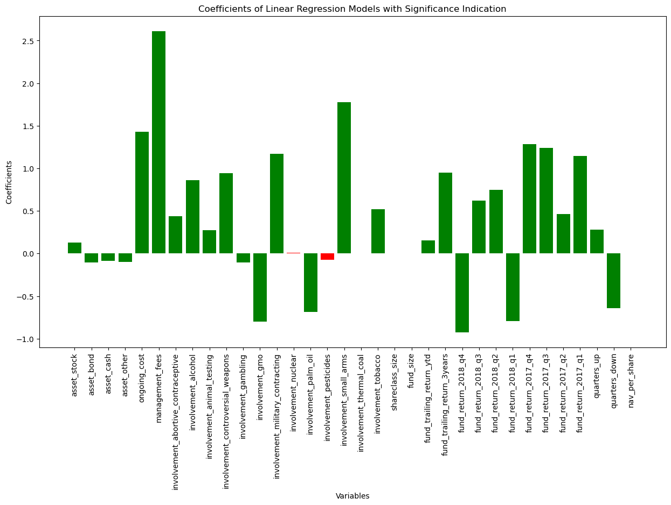
Feature selection Linear Regression Coeffecients
RandomForest, Intial Model​
Considered only​ 'asset_stock', 'asset_bond', 'involvement_abortive_contraceptive', 'involvement_animal_testing',
'fund_trailing_return_3years', 'fund_return_2018_q4', 'fund_return_2018_q2', 'fund_return_2017_q4', 'fund_return_2017_q3', 'fund_return_2017_q1'
Mean Squared Error: 6.78430520097892 R² Score: 0.9155706219657613

Slide 25
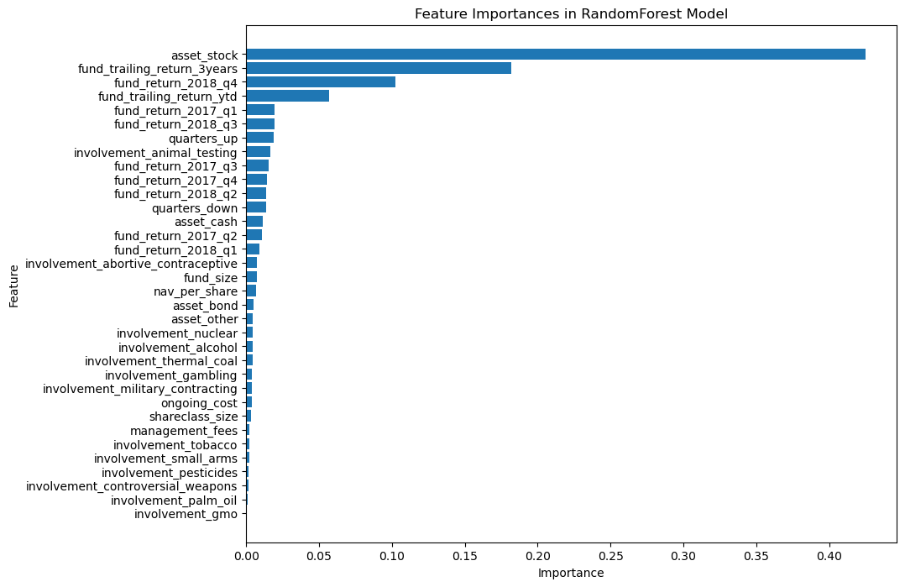
RandomForest
Hyper parameter Tuned and
3 fold cross validated
Selected Grid Search params: 'n_estimators’: 70,
'max_depth’: 10,
'min_samples_split’: 40,
'min_samples_leaf’: 4
Mean Squared Error: 4.073322544474462
R² Score: 0.9493082815741842

Slide 26
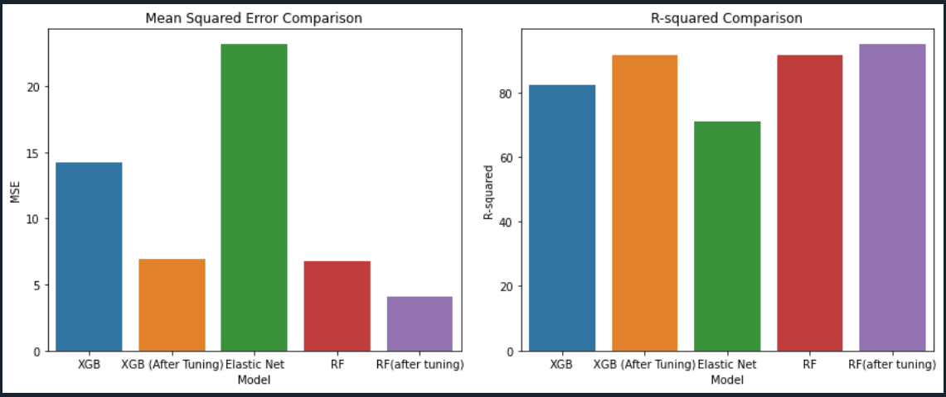
Model Comparison

Slide 27
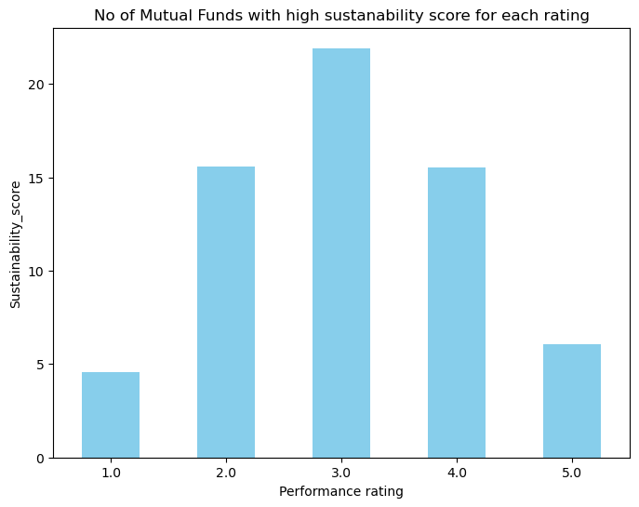
Some key insights
The fund category that has shown the most improvement in average return over the past
three years? - ('Russia Equity', 38.900786516853934)
There is a statistically significant difference in management fees between funds with high and low sustainability scores.
t_stat, p_value - (5.9661879505205135, 2.5328285652203307e-09)
How do funds with a low risk rating and high sustainability score perform in terms of 10-year trailing return? - 5.5802272727272735​

Slide 28
Strategies followed by the high risk rating Funds.¶
US Growth Funds Investment Objective: This strategy seeks long-term capital appreciation, primarily through investing in securities issued by US companies and, to a lesser extent, in securities from non-US companies. The criteria for considering a company to be from a particular country or region includes its principal securities trading market location, revenue sources, or country of organization.
European Property Funds Investment Objective: This strategy aims for long-term capital appreciation by investing in the equity securities of companies in the European real estate industry. This includes property development companies, those engaged in ownership of income-producing property, and collective investment vehicles with property exposure.
Investing in Asian (Excluding Japan) Equities: One strategy focuses on achieving capital appreciation by investing principally in the equity securities of companies domiciled in Asia (excluding Japan) or with significant Asian operations. This may include a mix of equities, fixed income securities, and other instruments.
Investing in Asian (Excluding Japanese) Equities: Another strategy involves long-term capital growth through investment in a portfolio of Asian (excluding Japanese) equities. This includes companies domiciled in, based in, or conducting a major part of their business in Asia, including both developed markets and emerging markets.
These investment strategies represent a focus on geographic diversification and specific industry sectors, reflecting the varied approaches taken by high risk-rated funds to achieve capital appreciation. The count next to each strategy indicates the number of funds employing that particular strategy

Slide 29
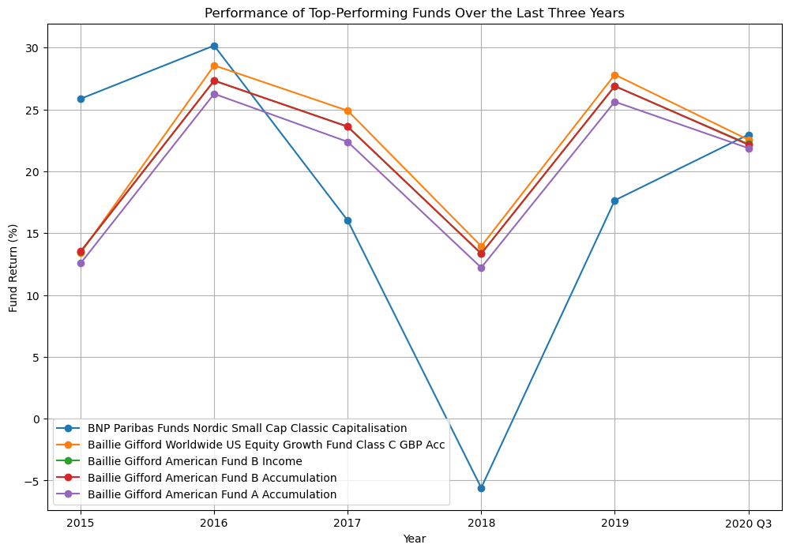
Top-performing funds in the last quarter, and have they consistently outperformed over the last three years?
Remember 2018 the fund returns were very bad 2018. BNP paribas performed worser than others.

Slide 30

Thank you!

